Slide 1

Lead Score Case Study

Slide 2
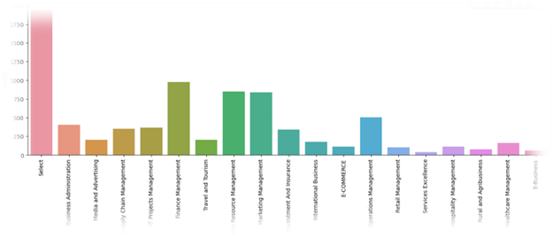
Problem Statement
An education company- X Education is looking for potential customers who would use its Education platform for upskilling. The company notes the leads – leads are the ones who shows an interest to join the different courses.
X Education requires to build a model where in ,we need to assign a lead score to each of the leads.
Customers with higher lead score have a higher conversion chance and the customers with lower lead score have a lower conversion chance.
In order to get a better lead conversion rate, the company needs
to identify the ‘hot leads’.
Hot Leads are the most potential leads who will eventually be the
customers.

Slide 3
Analysis - Flow
Step 1.Importing the Data Step 2.Inspecting the Data
Step 3.Data Cleaning and Preparation
Exploratory Data Analysis
Checking Outliers Step 4. Test – Train Split Step 5.Feature Selection Step 6.Model Building
Step 7.Plotting the ROC Curve Step 8.Finding Optimal cut off Step 9. Prediction making

Slide 4
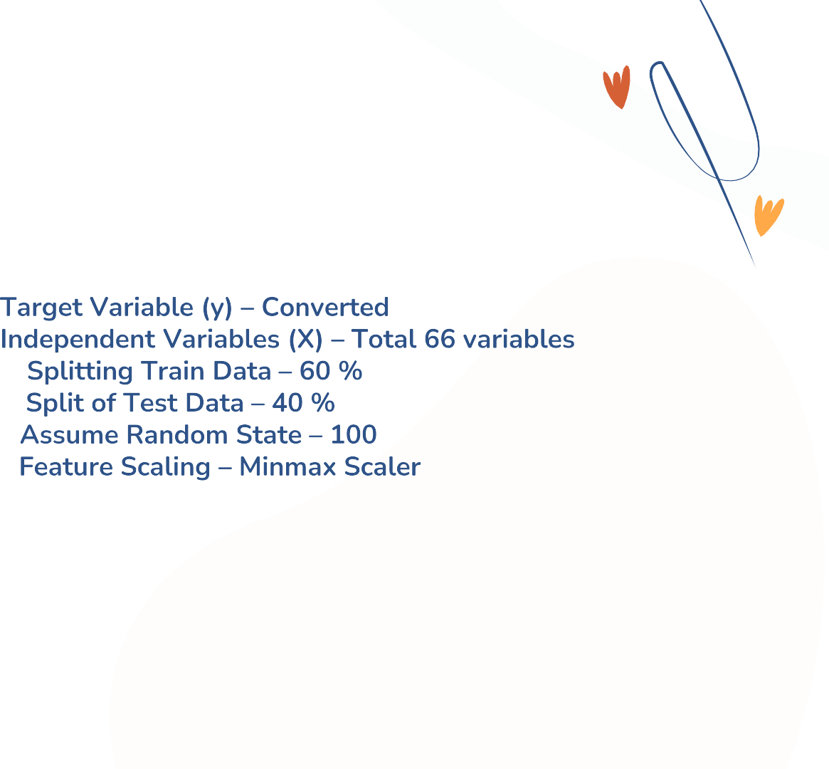
Test – Train Split

Slide 5
Model Building
Feature Selection – RFE a logistic regression model was built in
Python using the function GLM() under statsmodel library.
Some variables were removed first based on an automated approach, i.e. RFE (Running RFE with 20 variables)
Manual approach based on the VIFs and p-values are used for further process.
After dropping some columns which has p-values above 0.05 and
very high VIF we have obtained our final model with 14 variables.

Slide 6
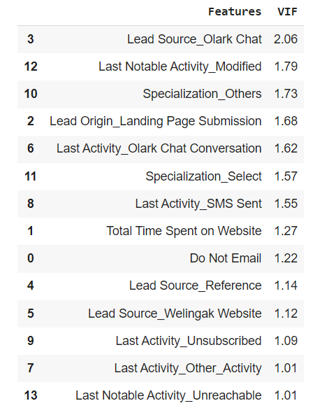
Features of final model

Slide 7

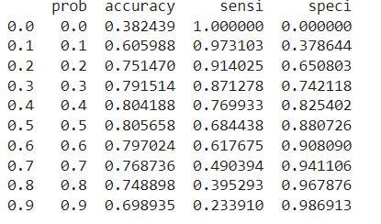
Metrics for Probability Cut Off

Slide 8
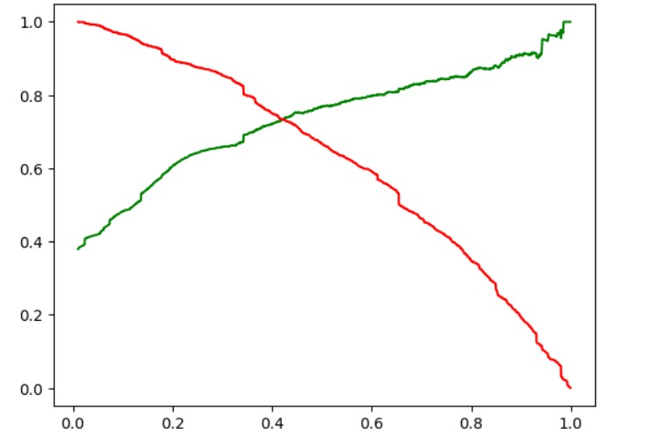
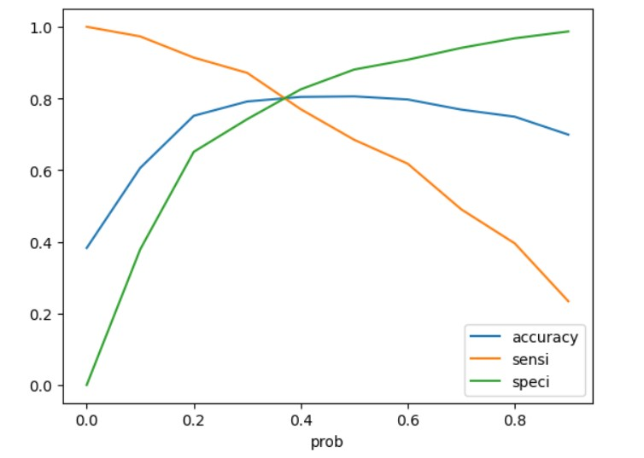
Finding optimal cut off
Optimal cut off was arrived using Sensitivity, Specificity, Accuracy and precision and recall Trade-off .
The optimum point to take it as a cut off probability is 0.38
Fig 1. Cut off taking accuracy, sensitivity and
specificity
Fig 1. Precision Recall Trade off curve

Slide 9
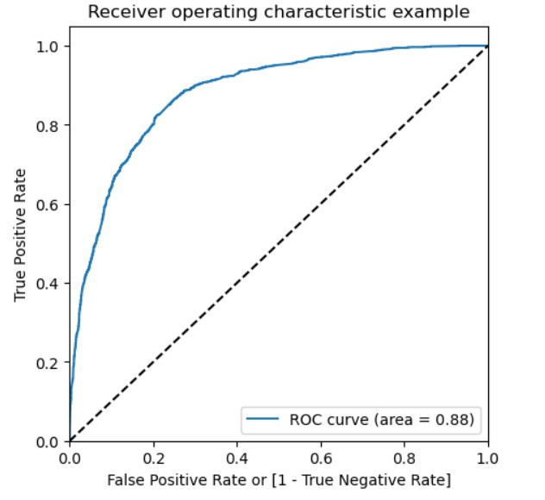
ROC Curve
ROC Curve indicates the trade off between sensitivity and specificity.
The closer the curve follows the left-hand border and top border of the ROC space, the more accurate the test.
ROC Curve area is 0.88, which is good.

Slide 10
Making predictions on the Test Data
A cut-off point of .38 is chosen based on the precision and recall tradeoff curve.
Based on the predictions on the test dataset we have obtained the values for Sensitivity (77.67%),Specificity
(80.72% )
Results
Trained Data | Test Data
Accuracy – 79.57 % | Accuracy – 79.58 %
Sensitivity – 85.06 % | Sensitivity – 77.67 %
Specificity – 76.17 % | Specificity – 80.72 %
Precision – 78.03 % | Precision – 70.53 %
Recall – 68.44 % | Recall – 77.67 %

Slide 11
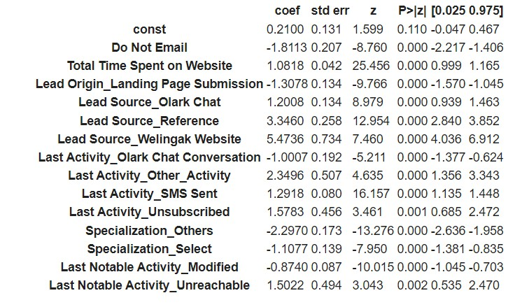
Final Model

Slide 12
Conclusion
Company should focus more on the below features to get a lead converted.
Last Activity
Lead Source
Total Time spent on the website
As we see, Lead Source_Welingak Website and reference has the highest positive impact on the lead conversion, company should focus more on the referral leads during the aggressive calling phase.

